Slide 1
How Ecosystems Are Different and Alike
Billy Costello
Nick Poplawski
Preeya Achari

Slide 2
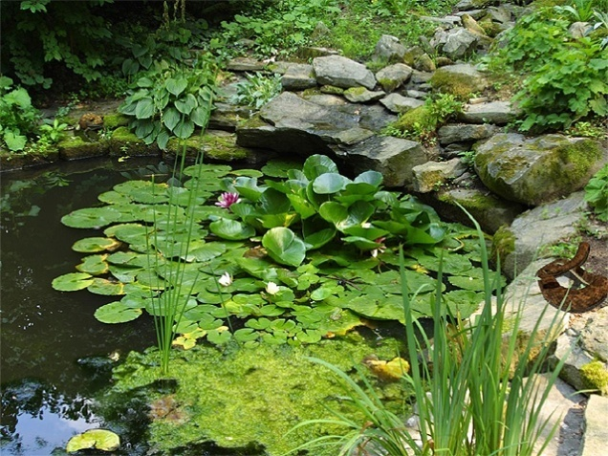
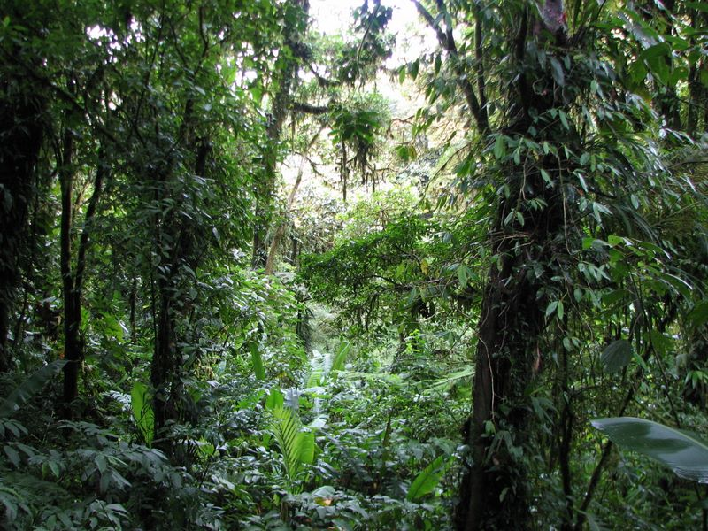

Ecosystems; Different or the Same
Many people don’t realize how ecosystems are similar. Most people just say, “The desert has sand and the arctic has snow. They are totally different.” They were wrong. Even opposites always have something different. We are going to prove that to you with these environments.
Rainforest
Desert
Forest

Slide 3
Desert
Rainforest
Unlike the rainforest the desert is very dry. It has almost no plants and no humidity. Most of the worlds mountain lions take refuge in the deserts. And also the good looking background of the mountains lie in this area. There is some
rain in the desert , but it evaporates before it before it hits the ground.
The rainforest usually has taller trees than average. It gets more precipitation than most other ecosystems. It has more exotic animals than the forest. It could be extremely hot during the day and freezing cold during the night. Home to the
world’s largest flower.
Similarities
All these ecosystems have many living things in them(Both plants and animals).
All these ecosystems also have ground plants (Flowers, bushes, etc.).
They all have communities of animals.
They are all livable for the average person.
They all have abiotic features.
Forest
The forest is much like the rainforest, except it doesn’t get as much precipitation. It has less exotic organisms than rainforests and deserts. It is not as hot as it is in the desert.
It is not as cold as the rainforest at night. They could
only have small ponds, but the rainforests can have
lakes in them.

Slide 4
As you can see, totally opposite ecosystems can be similar in several ways. Most people don’t realize that. Everyone thinks that all environments are their own thing. Think about that.

